Slide 1

Implementing a Hotspot
Lending Library
Cuesta College
Donna K. Howard, MA
Student Support Resolution Coordinator
Leslie Foshee
Library Coordinator

Slide 2
Assess Student Needs
Similar to food and housing, technology has become a basic need to today’s college student. However, technology is not equally available to all students. Students without internet access miss out on a huge educational opportunity, which in turn impacts their future.
Low-income students often do not have access to devices at home. This leaves them at a disadvantage as without internet they are prevented from opportunities to improve their quality of life.
Imperative to determine student need in order to learn what percentage of students are without the basic need of technology and internet access.
Notes:
It has been reported that up to 70% of schools nationwide do not have a high-speed internet connection. High-speed internet allows users to keep up with growing website demands and access information in a timely manner. Not having this valuable asset makes it difficult for students to access educational videos on YouTube, articles addressing current events which impact their lives, and online test or quizzes required in their coursework. Further, having access to the internet allows students to keep up with information that might not make it into textbooks or that might become outdated by the time it is published in a traditional format.
For the College Student that can mean access to scholarships; internships and employment.

Slide 3

Best Way to Administer Survey
Phone
Mail
Email
In Person
Each form of administering a survey has its own mix of benefits and drawbacks in terms of relative data quality, level of student response, and cost. Web-based internet surveys are generally the most effective and inexpensive way to gather student data. If a campus does not have its own Institutional Research department, software such as Qualtrics or Survey Monkey are simple to use and are often free to college campuses.

Slide 4

What Questions to Ask on the Survey
Work backwards and start with what you want to know from the students.
Continually ask yourself “why” do we want that question included?
  How will the data be used?
  Who will use the data on campus?
  How will it assist in increased student persistence and resilience?
Limit the number of questions
  And limit the number of possible answers
Consider providing an incentive
  Money for each participant is preferred
  Raffle of gift cards, swag also work well
Notes:
1. For instance, we wanted to know how many students were without 24/7 reliable internet at their homes. However, we forgot that in a college student’s mind, using their smartphone as their technological device and by default having internet access on their phone, would not result in what we were interested in learning. So we had to revise the question to ask “Do you have reliable 24/7 internet from a device other than your smart phone?”

Slide 5

Analyze the Data
Look at how many students responded
Who responded (check out all demographics)
Who did not take the survey
Look for trends
Look for under or over-represented groups
Create a report
Provide it to all departments

Slide 6
Resources to Implement your Lending Library
Use your community!
The Community College Librarians Listserv is how we found the Digital Wish/Mobile Beacon grant program.
We found this program to be reasonably priced and more importantly, sustainable.
Digital Wish Donation Program | Mobile Beacon
Outside of the Digital Wish Foundation, Mobile Beacon is still the most affordable at $69 per device and a $10 monthly service fee.
Once we decided on a company and received a quote, we looked for funding through our Foundation/Friends, CARES funds.

Slide 7
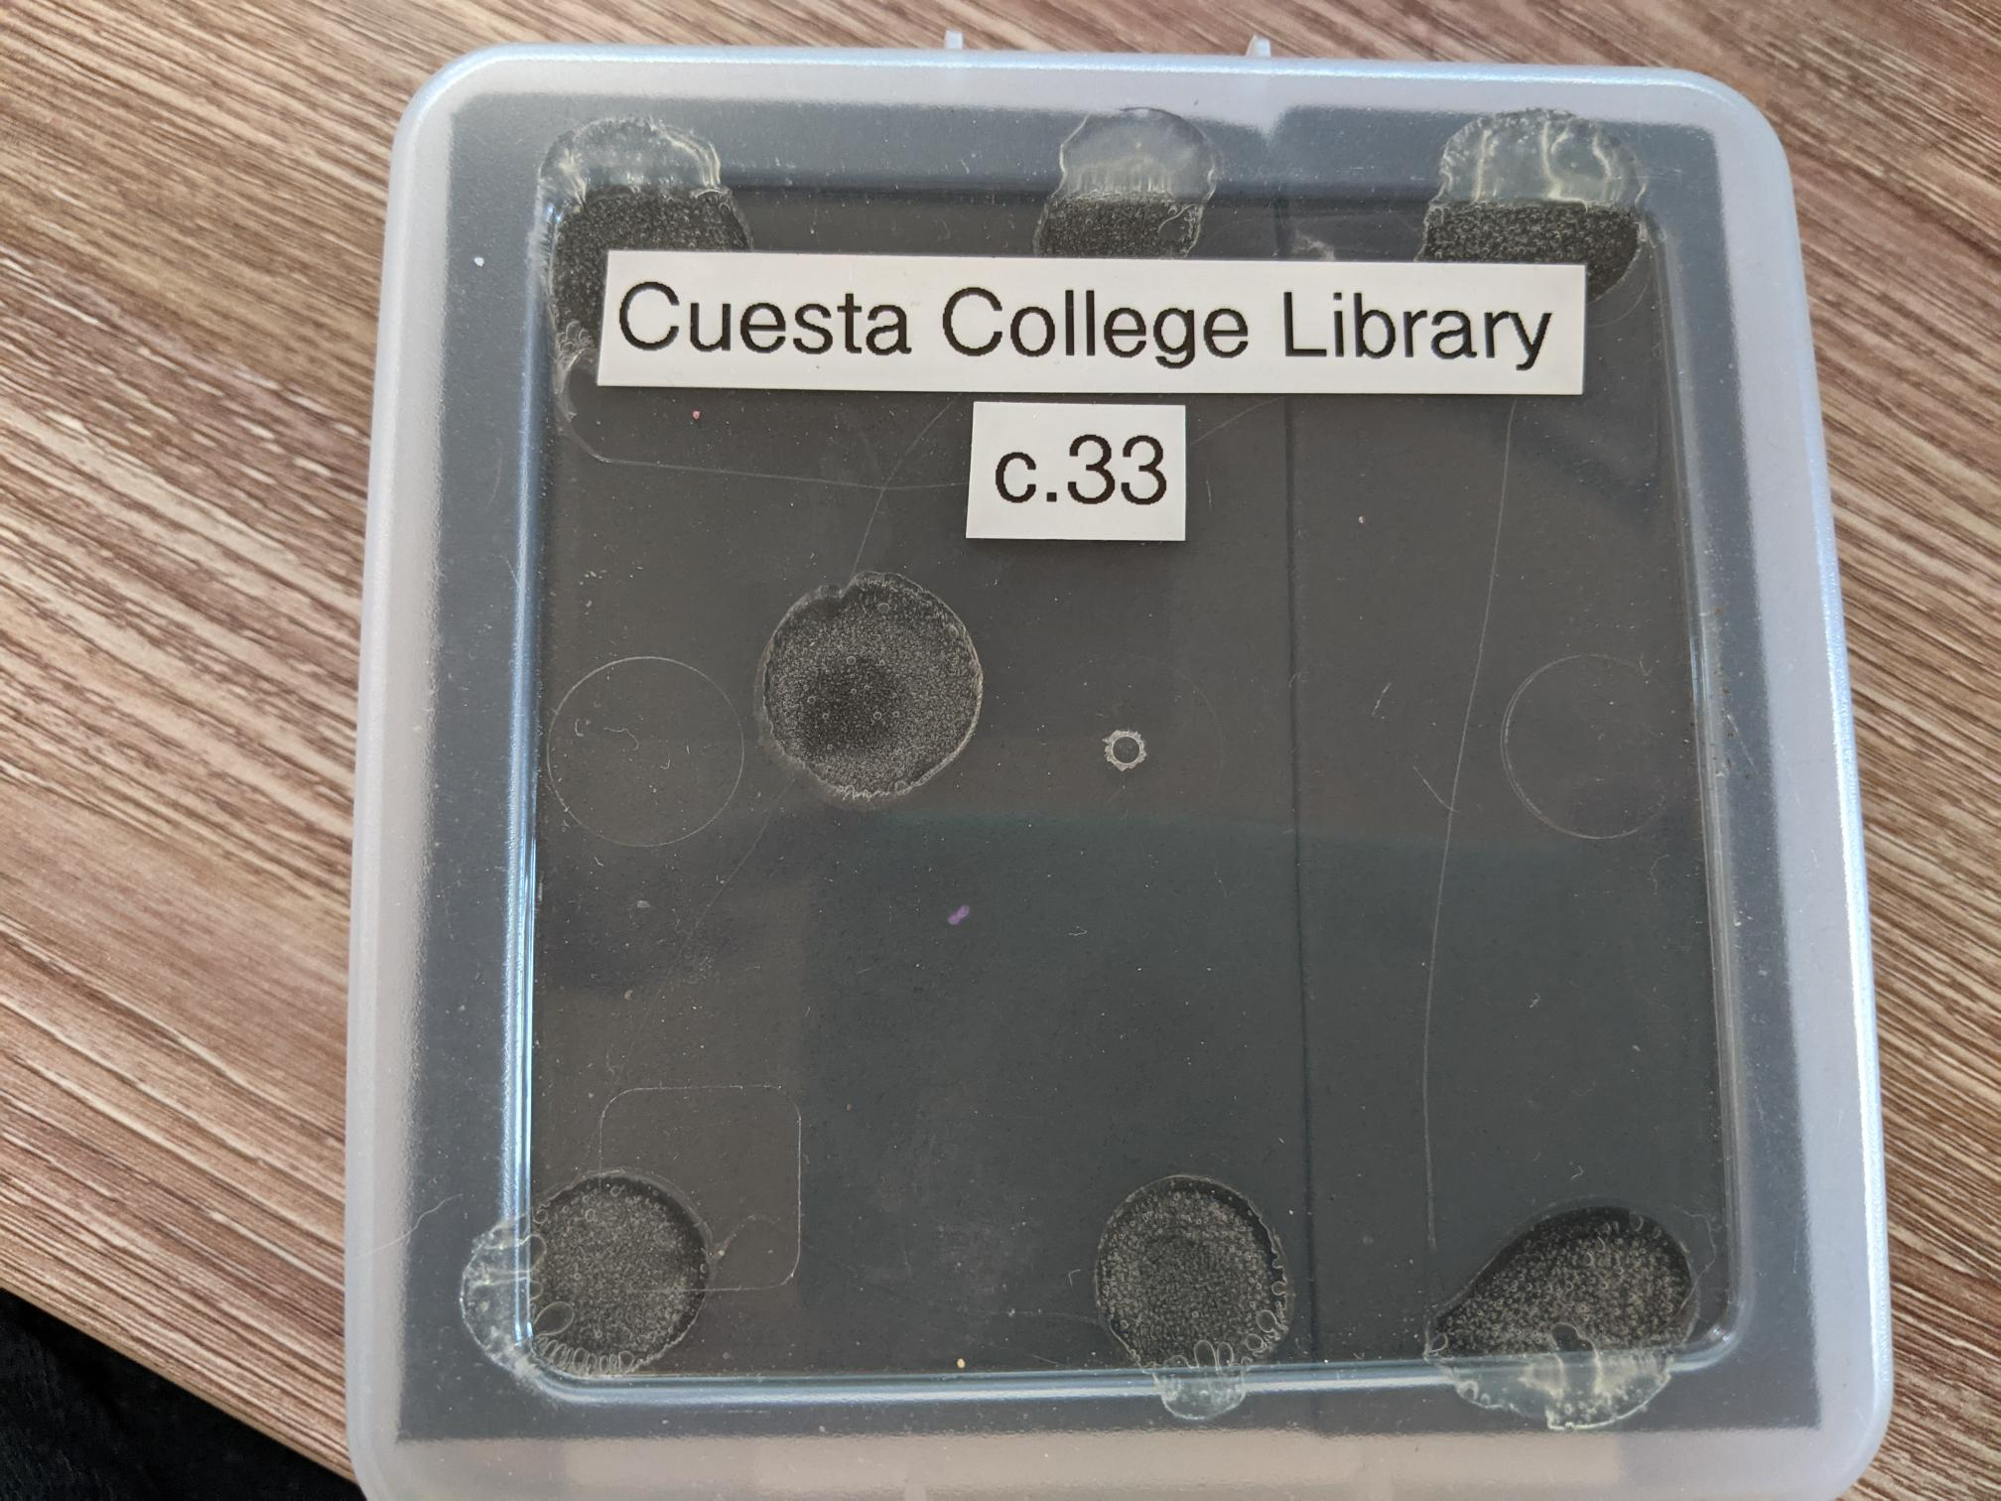
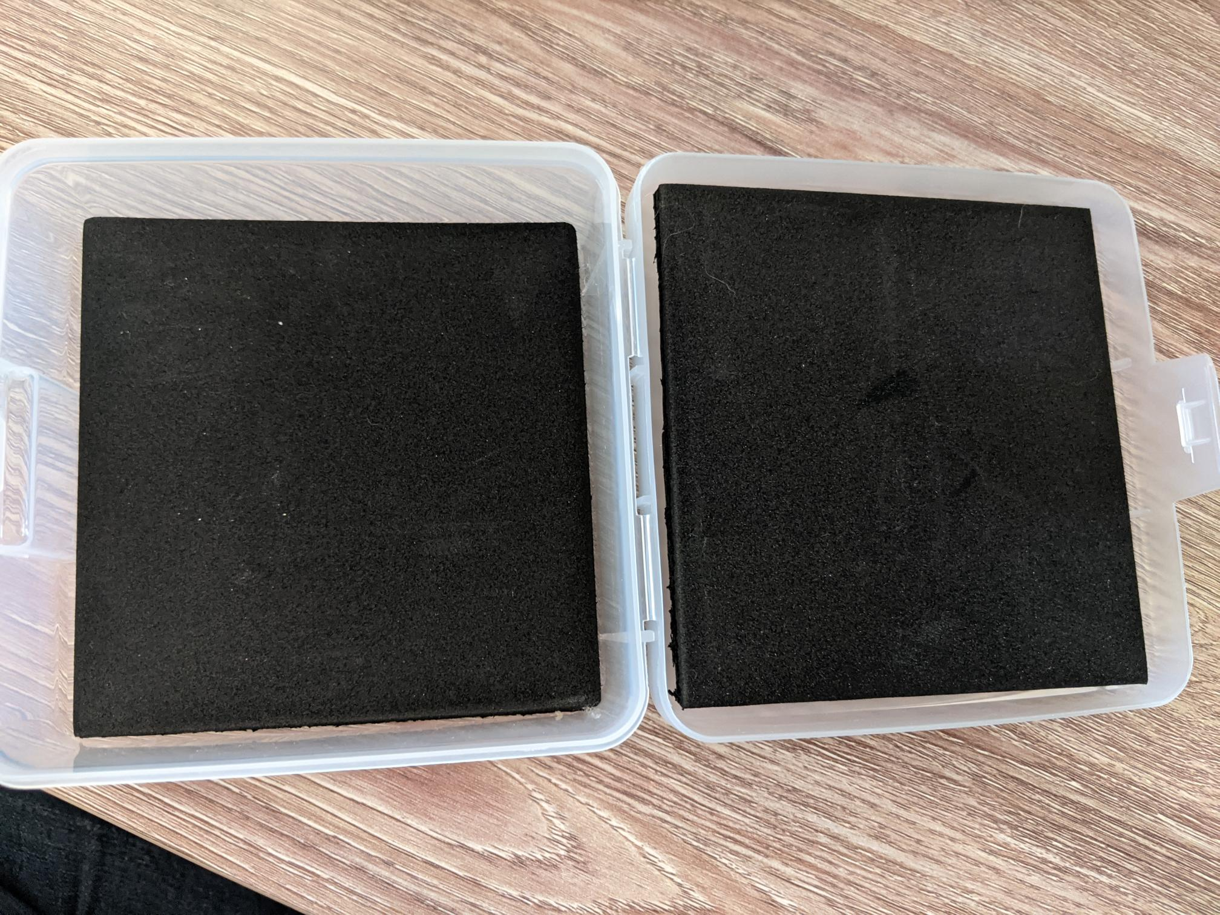
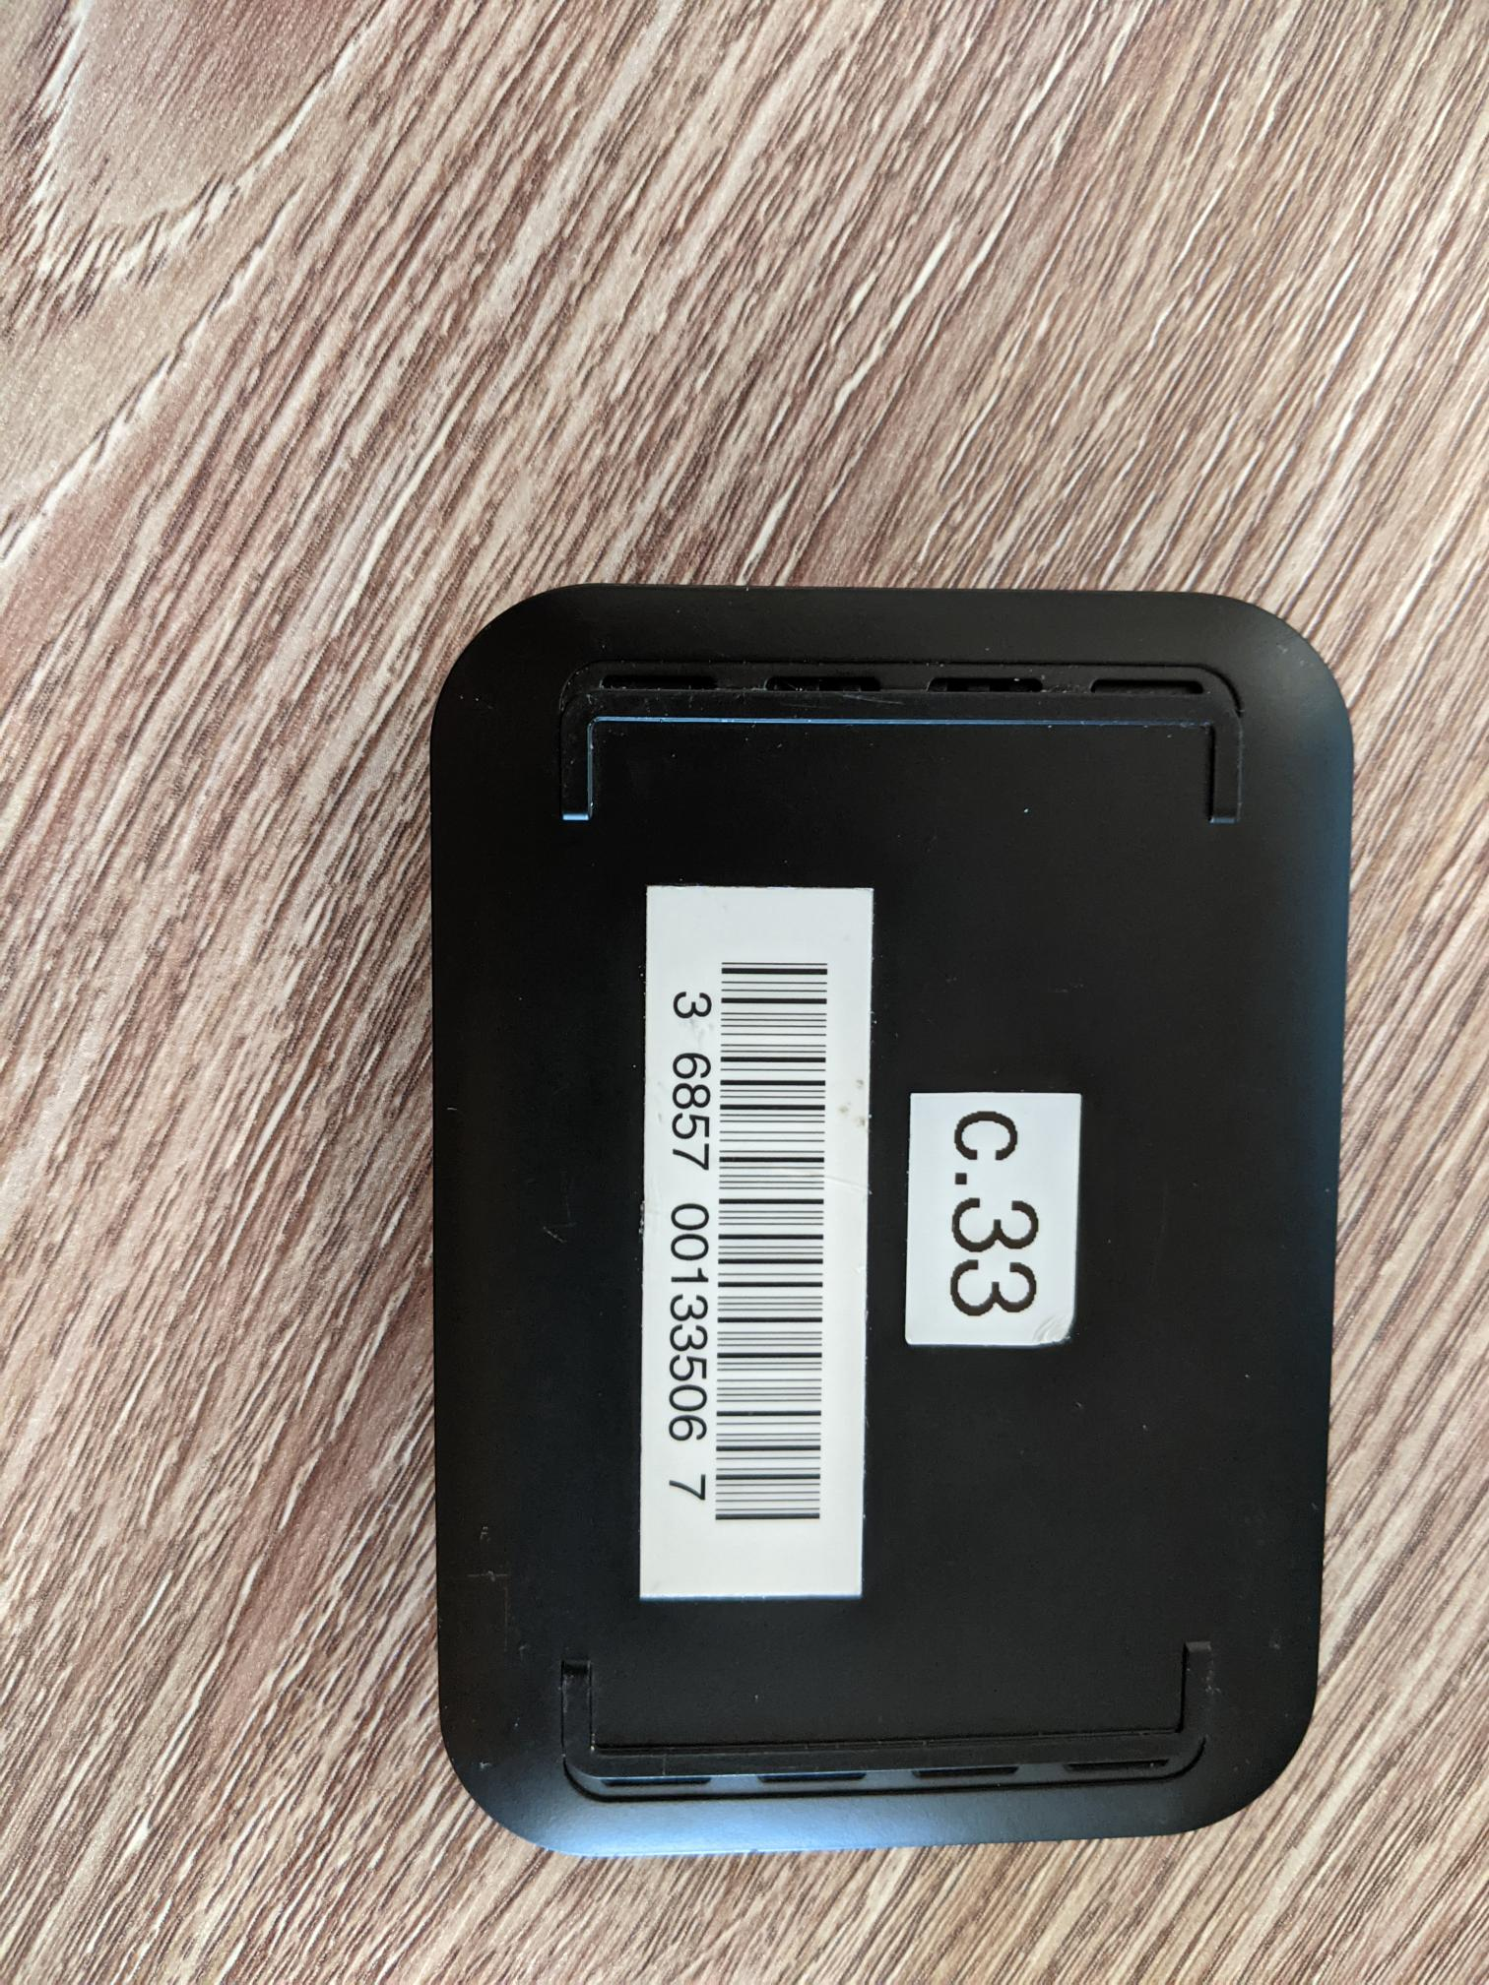
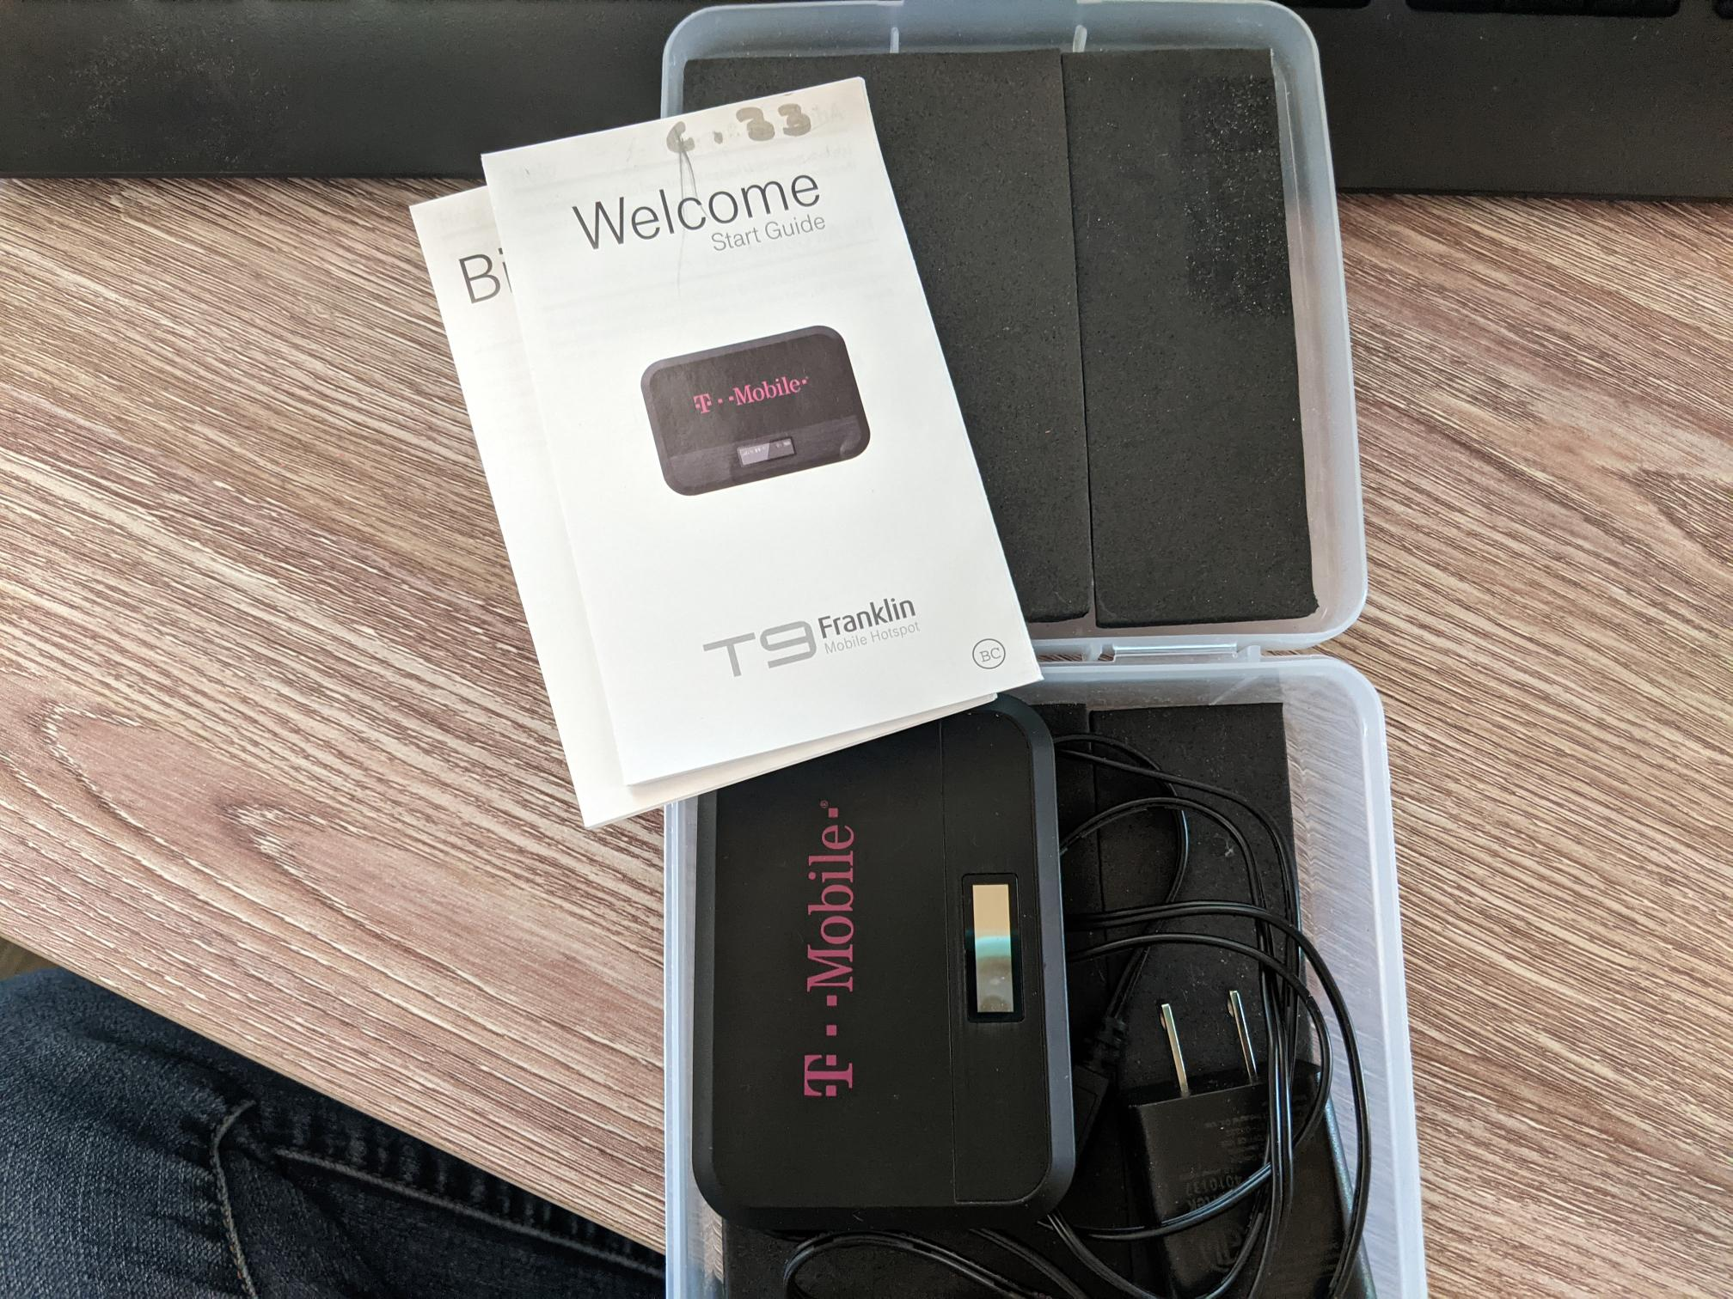
Processing your New Devices
Hotspot Packaging Links
Amazon.com: IRIS USA MCC Scrapbooking case, Small, Clear, 10 Pack: Home & Kitchen
Amazon.com: Winlyn 20 Pcs EVA Foam Sheets 6mm Craft Foam Cosplay Foam 9" x 12" Black Foam Boards with Cutting Mat Compass Hobby Knife Ruler Pencils for Cosplay Boy Scouts Halloween Crafts Projects Cushion: Arts, Crafts & Sewing
Amazon.com: Houseables Crafts Foam Sheets, Art Supplies, EVA, 6mm Thick, Black, 20 Pack, 9 X 12 Inch, Paper Scrapbooking, Cosplay, Crafting Foams Paper, Foamie Crafts, for Kids, Boy Souts, Halloween, Shoe Insole: Arts, Crafts & Sewing (Does not include cutting mat, exacto knife and ruler)

Slide 8
Lending Policies
Lending policies for electronic devices can be found on our User Agreement Form on our Library website: Hours and Policies (cuesta.edu)
Students must fill out a new agreement form each semester (not per device).
We file agreement forms in case a problem comes up and we need to refer to it.

